Slide 1
An Introduction to
Computational Thinking
& Code

Slide 2

A series of steps
Algorithms
(sequences & rules)
Notes:
If you’ve ever followed the instructions for a fire drill, you’ve followed an algorithm. Everyone follows the same set of step-by-step instructions. This is a great example for teachers to use in the classroom because it also reminds children of a really important lesson in school - what to do during a fire alarm.
Ask about other examples?
Building with clear stages: snowman
bedtime/sleep routine
Planting something
Programmers often work in teams on pretty complex algorithms. So being able to break a problem down into small parts is a very important skill. Can you think of a time recently when you broke a problem down to make it easier? Cleaning a room one section at a time, Making a snowman: make the pieces first and put them together
- puzzles: making the edges first
- murals: each person does a little part

Slide 3

Decomposition:
Reduce a complex problem into small pieces
Decomposition
(breaking down into parts)

Slide 4
Q. If today is Monday, what is the day after the day before the day before tomorrow?
Logic
(analyzing and predicting)
Notes:
A. Monday

Slide 5
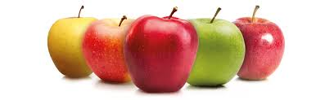

5 apples + 3 oranges =
how many fruits?
Abstraction
(keeping the information you need)

Slide 6
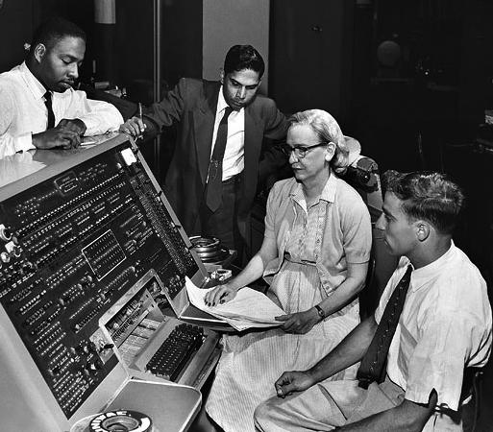
Guess the famous computer scientist!
Notes:
This slide highlights the important role of women in the history of computer programming.
Grace Hopper was the first programmer on the Harvard Mark 1, the first programmable computer. She created the first compiler, wrote the first programming manual, and oversaw the creation of COBOL the first commercial computer language.
Many of the practices she developed are still in use.

Slide 7
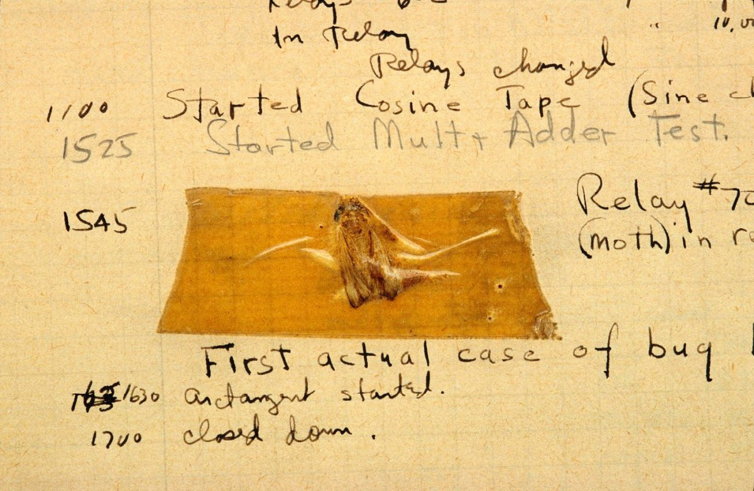
Debugging
(identifying and correcting errors)
Notes:
A fly from Grace Hopper’s blog
Grace Hopper is credited for coining the term “debugging”. In Computer programming, debugging means getting rid of problems in the code. One of Grace Hopper’s computer glitches was actually being caused by a moth in the back of her computer! Debugging has become a very important programming technique because the more code there is, the more bugs there are!
* If your program runs perfectly the first time, ask yourself the question “Why did it work?”

Slide 8
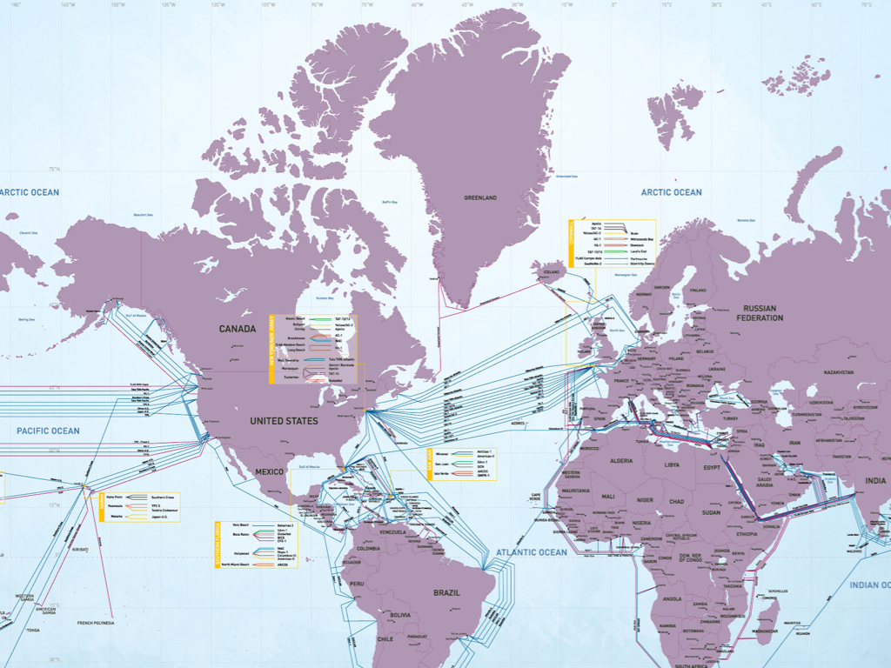
What is the map showing?
Notes:
the internet is the infrastructure, it’s the cables, the fibre optic, the wireless hardware and links, the smart switches and routers that connect together devices from clever thermostats, smartphones, tablets and laptops to servers, mainframes and data centres.

Slide 9

What does WWW.
stand for?
And what does it do?
Notes:
World Wide Web. An example:
If the internet is the roads, railways and canals then cars, trains and boats all travel around the transport network. The world wide web is the data which travels around the internet to get web pages to your PC.
The Internet is about connecting computers, the web is about connecting documents; it’s like the difference between your brain and your memories.

Slide 10

Ahat
What is a
Computer?
Notes:
Before we start to learn about coding, we want to learn about the environment and the tools that are often involved in our coding experience.
Ask the students to talk about what a computer means to them? Do they use a computer in school? Do they use it to play? What do they use a computer for?

Slide 11
Hardware = hard drive, memory etc…
Software =
computer programming = CODE
Notes:
A computer is made up of
Hardware [physical]: such as memory, hard drive and processor – allows the computer to do something
(non computer examples):
Soccer field, goal posts, ball and players
a piano
Software gives instructions to the computer – how the computer does something
(non-computer examples)
Pool: tell the swimmer when to start, when to stop, what stroke to use, when to breathe
Soccer: tell the players which position to play, how to kick the ball
Sheet music: tells the pianist what to play

Slide 12


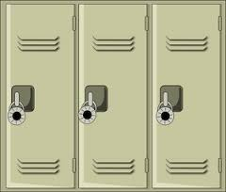
What does the word code mean to you?
Notes:
Question to the audience: Name types of codes other than computer programming?
Some answers
Code of conduct
Code of ethics
Dress code
Morse code
Emoticons
Facial expressions
Languages (spoken, written, sign)
Colour codes
The word code means many things to many people. Secret codes, codes of conduct, codes that organize information, like colour coding, or codes that tell us what to do in a crisis. Humans seem to be built to code and de-code. If you’ve learned to read, learned basic math, learned a recipe, you’ve already developed some coding skills that you can transfer to the project of learning computer code.
So, you already know how to code, you are simply learning one more way to do it.

Slide 13
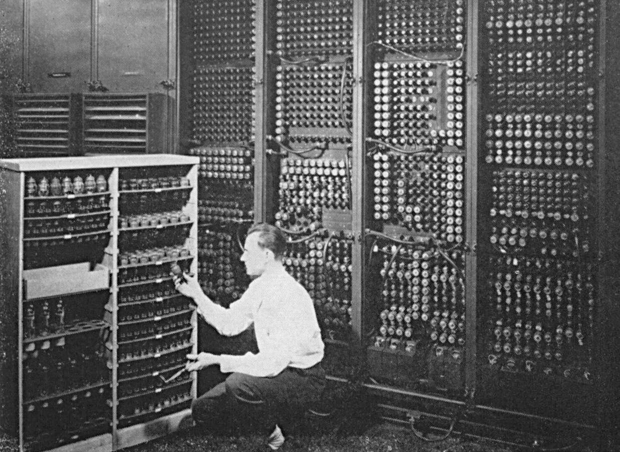
Computer code is...
how we tell computers what to do
Notes:
Computer code might seem pretty complicated when you look at it, but basically this is what it is, a way to tell computers what we want them to do.
Some questions to ask:
What are your first memories of using a computer?
Where are the computers? Name some computers we use every day which don’t look like the picture: watches, coffee makers, smart phones, calculators, etc…
Do computers have brains? No! The human is the brain, computers simply follow instructions very very fast.

Slide 14






Ahat
What are
these
images?
Notes:
There many computer programming languages! Some are useful for web development, others useful for writing desktop software like Microsoft Word, others great for making games.

Slide 15


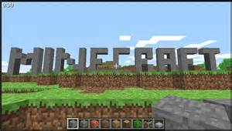
What do you use
a computer for?
Notes:
Computer programmers around the world write code that you use every day!

